Slide 1

SMART INDIA HACKATHON 2026
GUARDIANS
SEE | TRACE | PROTECT OUR OCEANS
Problem Statement ID : 26143
Problem Statement Title
Leveraging satellite imagery to determine oil spills at sea along with AIS data correlations to identify the vessel responsible for the spill
Theme : Disaster Management
PS Category: Software
Team ID: BMS/SIH2026/124
Team Name: Who Spilled it

Slide 2
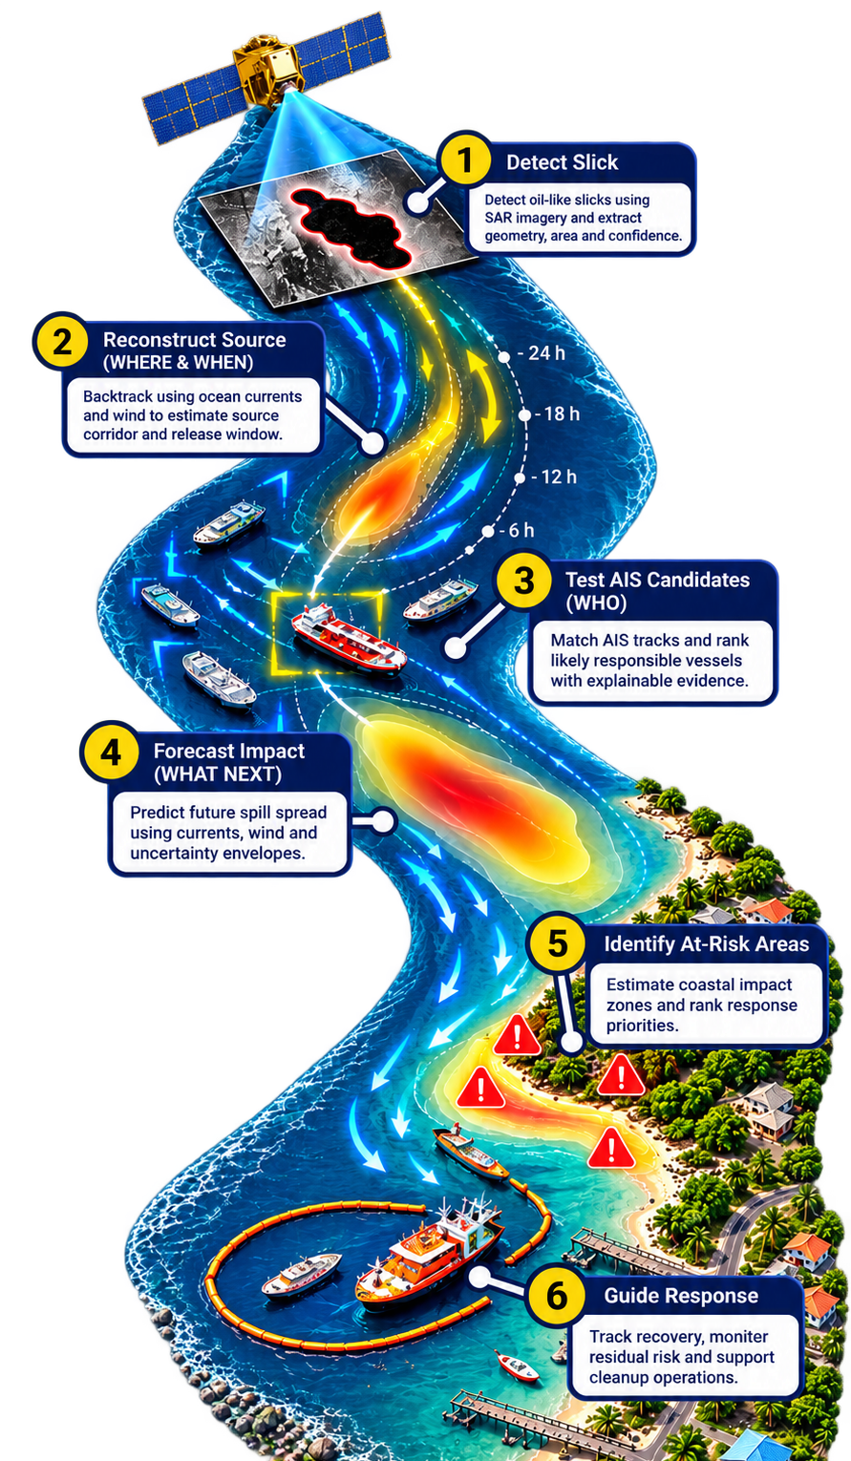








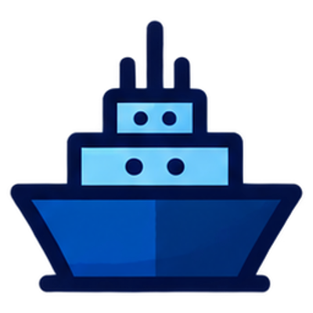

Proposed Solution
Guardians
Who Spilled It
Real World Problem
Architecture Diagram
Hard to detect oil early
Easily confused with look-alikes
Hard to find the source
Current and winds move oil.
Delay increases damage
Current and winds move oil.
Need source accountability
Enables faster response, accountability
Our Solution – ‘Guardians’
Detects & validates oil spills
Distinguishes potential spills from look-alikes.
Uniqueness and Innovation
Backtracks spill movement
Estimates WHERE and WHEN it originated using ocean currents, wind, etc.
Realistic physics model with both past and future forecast
Reproducible forecast with uncertainty-aware conclusions and a traceable evidence chain.
Identifies potential source vessels
Matches historic AIS tracks to source.
Lightweight ResNet-18 enables efficient inference and edge-device deployment.
Forecasts future spill movement
Predicts WHERE the spill may go next to
support faster response and cleanup planning
Modular architecture enables independent, parallel execution of analysis modules.
@SIH Idea submission- Template

Slide 3
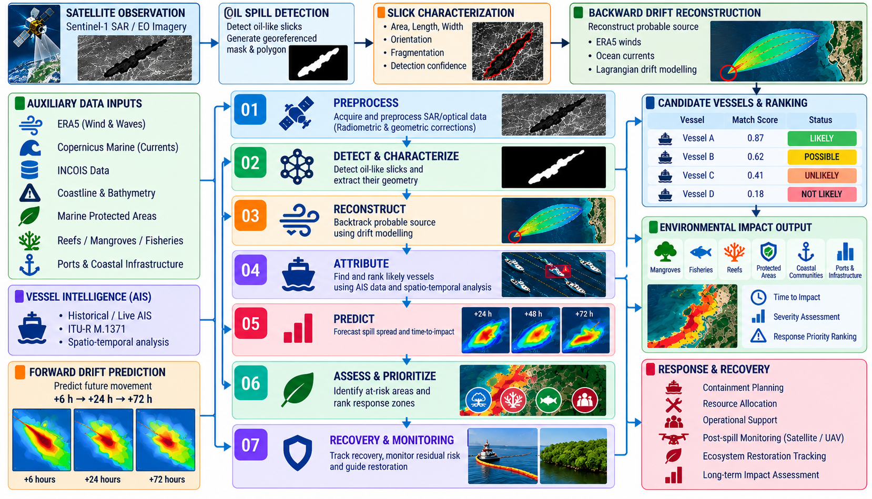




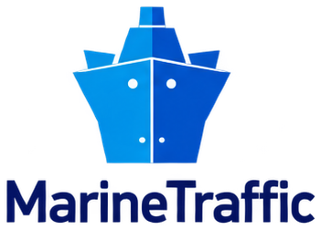


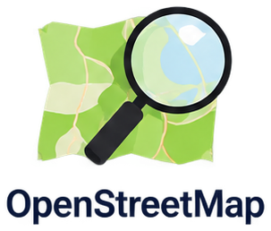















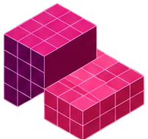
Who Spilled It
Technical Approach
Data Sources
SAR Imagery
Weather
Currents
Environment
AIS Tracks
Marine & Land
Bathymetry
Coastline
Tech Stack
Frontend
React
TypeScript
Vite
Zustand
Geospatial
CesiumJS
PostGIS
GDAL
GeoPandas
AI
& Backend
Python
PyTorch
FastAPI
Node.js
Data
& Storage
PostgreSQL
NumPy
Pandas
Zarr
Deployed Prototype
13,739
18,770 km²
643
79
Interactive 3D analysis of
SAR, ocean & AIS data
Slick area
mapped
AIS vessels
screened
Satellite passes
cross-checked
@SIH Idea submission- Template

Slide 4











Who Spilled It
Feasibility and Viability
Feasibility
Built on available data, resilient engineering and practical deployment
Why It Is Viable
01
Technical Feasibility
01
02
03
Edge Compliant & Optimized
Runs efficiently on basic edge devices; can be parallelized to compute large data
Reusable & Scalable
Modular & Upgradeable
Operationally Sustainable
Applicable to new spill incidents and larger coastal regions.
Individual analytical modules can evolve independently.
Offline-ready, auditable outputs fit existing response workflows.
Fault Tolerant
Handles missing/weak data gracefully without producing unreliable results.
Key Risks & Mitigation
From uncertainty to assurance
Atomicity
Independent modules run separately and are parallelized for speed.
SAR Look-Alike Ambiguity
Multi-Feature Validation
02
Economic Feasibility
Dark ocean features may mimic oil slicks.
Radiometric, texture, morphology and confidence screening.
Low Infrastructure Dependency
Works with existing satellite, environmental and AIS information.
Environmental Forcing Uncertainty
Uncertainty-Aware Modelling
Cost-Effective
Uses existing data pipelines; very low setup and maintenance cost
Coarse wind/current fields reduce drift precision.
Interpolation, windage scenarios and particle-spread envelopes.
Maintainability
Modules can be swapped or upgraded easily
AIS Trajectory Gaps
Robust AIS Scoring
Missing or sparse vessel tracks weaken attribution.
Gap detection plus spatial-temporal-directional scoring.
03
Social Feasibility
Supports Faster Response
Identification and prediction significantly reduce response delay.
Data Resolution Mismatch
Spatio-Temporal Harmonization
Satellite, ocean and AIS datasets differ in resolution.
Interpolation, timestamp alignment, resolution-aware processing.
Protects Environment & Coastal Livelihoods
Timely alerts support cleanup and spill
response
@SIH Idea submission- Template

Slide 5
Who Spilled It
Impacts and Benefits
Impact on Target Audience
Benefits of Guardians
Who Benefits
Value Created
Why “GUARDIANS”
Maritime Authorities
Response Teams
Operational
One decision-support workflow from detection to response.
Faster incident assessment and source investigation.
Prioritised containment, surveillance and cleanup zones.
Environmental
Earlier protection through forward-drift prediction.
Economic
Focuses limited response assets on priority areas.
Investigators
Coastal Communities & Ecosystems
Governance
Traceable provenance, uncertainty and auditable evidence.
Evidence-backed vessel screening with explainable attribution.
Earlier awareness of areas threatened by spill movement.
Responsible AI
Abstains when evidence is insufficient; human stays final authority.
Competitor Analysis
✔ Supported ◐ Partial — Not available
Capability | CleanSeaNet | KSAT Oil Spill | SkyTruth Cerulean | Guardians
SAR Slick Detection | ✔ | ✔ | ✔ | ✔
WHERE + WHEN Reconstruction | ◐ | ◐ | ◐ | ✔
Explainable Vessel Ranking | ◐ | ◐ | ✔ | ✔
Forward Drift Prediction | ✔ | ◐ | — | ✔
Offline / Local Operation | — | — | — | ✔
How Guardians
“Stands out”?
It is the only system that integrates reconstruction, full explainability, prediction and offline readiness in one workflow.
From satellite observation to explainable operational decision support
Offline-ready
Uncertainty-aware
Human-in-the-loop
@SIH Idea submission- Template

Slide 6
Who Spilled It
Research and References
Primary Data Sources
Open datasets
Key Research Papers
Methods adopted in Guardians
Sentinel-1 SAR
dataspace.copernicus.eu
Marine oil spill detection and segmentation in SAR data with two‑step deep learning
DOI
10.1016/j.marpolbul.2024.116549
01
Copernicus Data Space · slick imagery
cds.climate.copernicus.eu
Marine Pollution Bulletin, 2024 · SAR slick classification + U-Net segmentation
ERA5 Wind
Copernicus Climate Data Store · wind fields
DOI
10.5194/gmd-11-1405-2018
02
OpenDrift v1.0: a generic framework for trajectory modelling
Ocean Currents
data.marine.copernicus.eu
Geosci. Model Dev., 2018 · Lagrangian drift engine for backtrack & forecast
Copernicus Marine Service · surface currents
Vessel / AIS Tracks
globalfishingwatch.org
Encoder-Decoder with Atrous Separable Convolution (DeepLabv3+)
DOI
10.1007/978-3-030-01234-2_49
03
Global Fishing Watch + NOAA MarineCadastre
ECCV, 2018 · precise extraction of slick boundaries
Bathymetry
gebco.net
GEBCO gridded ocean depth
Deep Residual Learning for Image Recognition (ResNet)
DOI
10.1109/CVPR.2016.90
04
Coastline & Land
osmdata.openstreetmap.de
CVPR, 2016 · ResNet-18 backbone for edge inference
OpenStreetMap land polygons
protectedplanet.net
05
TerraMind: Large-Scale Generative Multimodality for Earth Observation
DOI
10.1109/ICCV51701.2025.00693
Environmental Layers
ICCV, 2025 · fusing complementary geospatial signals
Protected Planet · coastal ecosystems
Prototype & Project Links
Scan to explore our own work
QR
QR
QR
QR
Live Webpage
YouTube Demo
GitHub Repository
Physics Simulation
Deployed prototype
Walkthrough video
Source code & docs
Drift model demo
link: ______________
link: ______________
link: ______________
link: ______________
@SIH Idea submission- Template

